Slide 1


WeFund
Community Crowdfunding Cross-Chain Incubator

Slide 2







MEET THE TEAM
Andrea Bello
Co Founder & CEO & Co-CTO
Most recently behind the development of a smart contract (Fan$quad) that was deployed Col-4 during a hackathon organized by Terraformlabs and former CTO of a Guild Game, successfully raising a $10 million Seed round. Founder of Mosquito Solution, an innovative natural misting system startup created and launched within 1 year, operating in Bali, Indonesia. Founder of Bello Service, Domotic System for smart-home efficiency, reducing electrical consumption by 30%. R&D engineer at ABB UPS system, an expert in coding C programming.
Ika Afifah
Co Founder & CMO
Previous CMO at Gamesta to successfully raise a $10 million Seed round. Prior to Guild Game, she worked at Tencent as an operation specialist, in a partnership division. Before Tencent, she was senior partnership manager at Bigo. She previously held a senior account executive position at one of the digital marketing agencies under Jet Group and was a manager at Waves who successfully helped founders to raise $1.2M in pre-seed funding.
Ika Nur Afifah

Slide 3


MEET THE TEAM
Jason Galvin
Co-CTO
World explorer, entrepreneur, and blockchain technology enthusiast. Came from a career in Silicon Valley building web applications during the dot-com boom. Wanting to do it all over again, this time helping to build Web 3.0.
Austin Taylor
CCO
Comes from a background in investment and corporate finance. After completing his education, he worked as a Business Analyst for a large tech company in Seattle, Washington USA building AI applications to identify high-risk sale transactions. He now is an Investment Manager for a prestigious silicon valley venture capital firm located in Jakarta, Indonesia managing investment deals in the Southeast Asia region.
Jason Galvin
Austin Taylor

Slide 4

What is
WeFund?
Community crowdfunding incubator for blockchain and real-world projects.

Slide 5

What is WeFund’s MISSION?
Host high-quality projects that align with WeFund’s investor community.
Community-driven decisions on the platform for 100% transparency.
Project funds managed exclusively on Terra’s Anchor protocol using smart contracts.

Slide 6




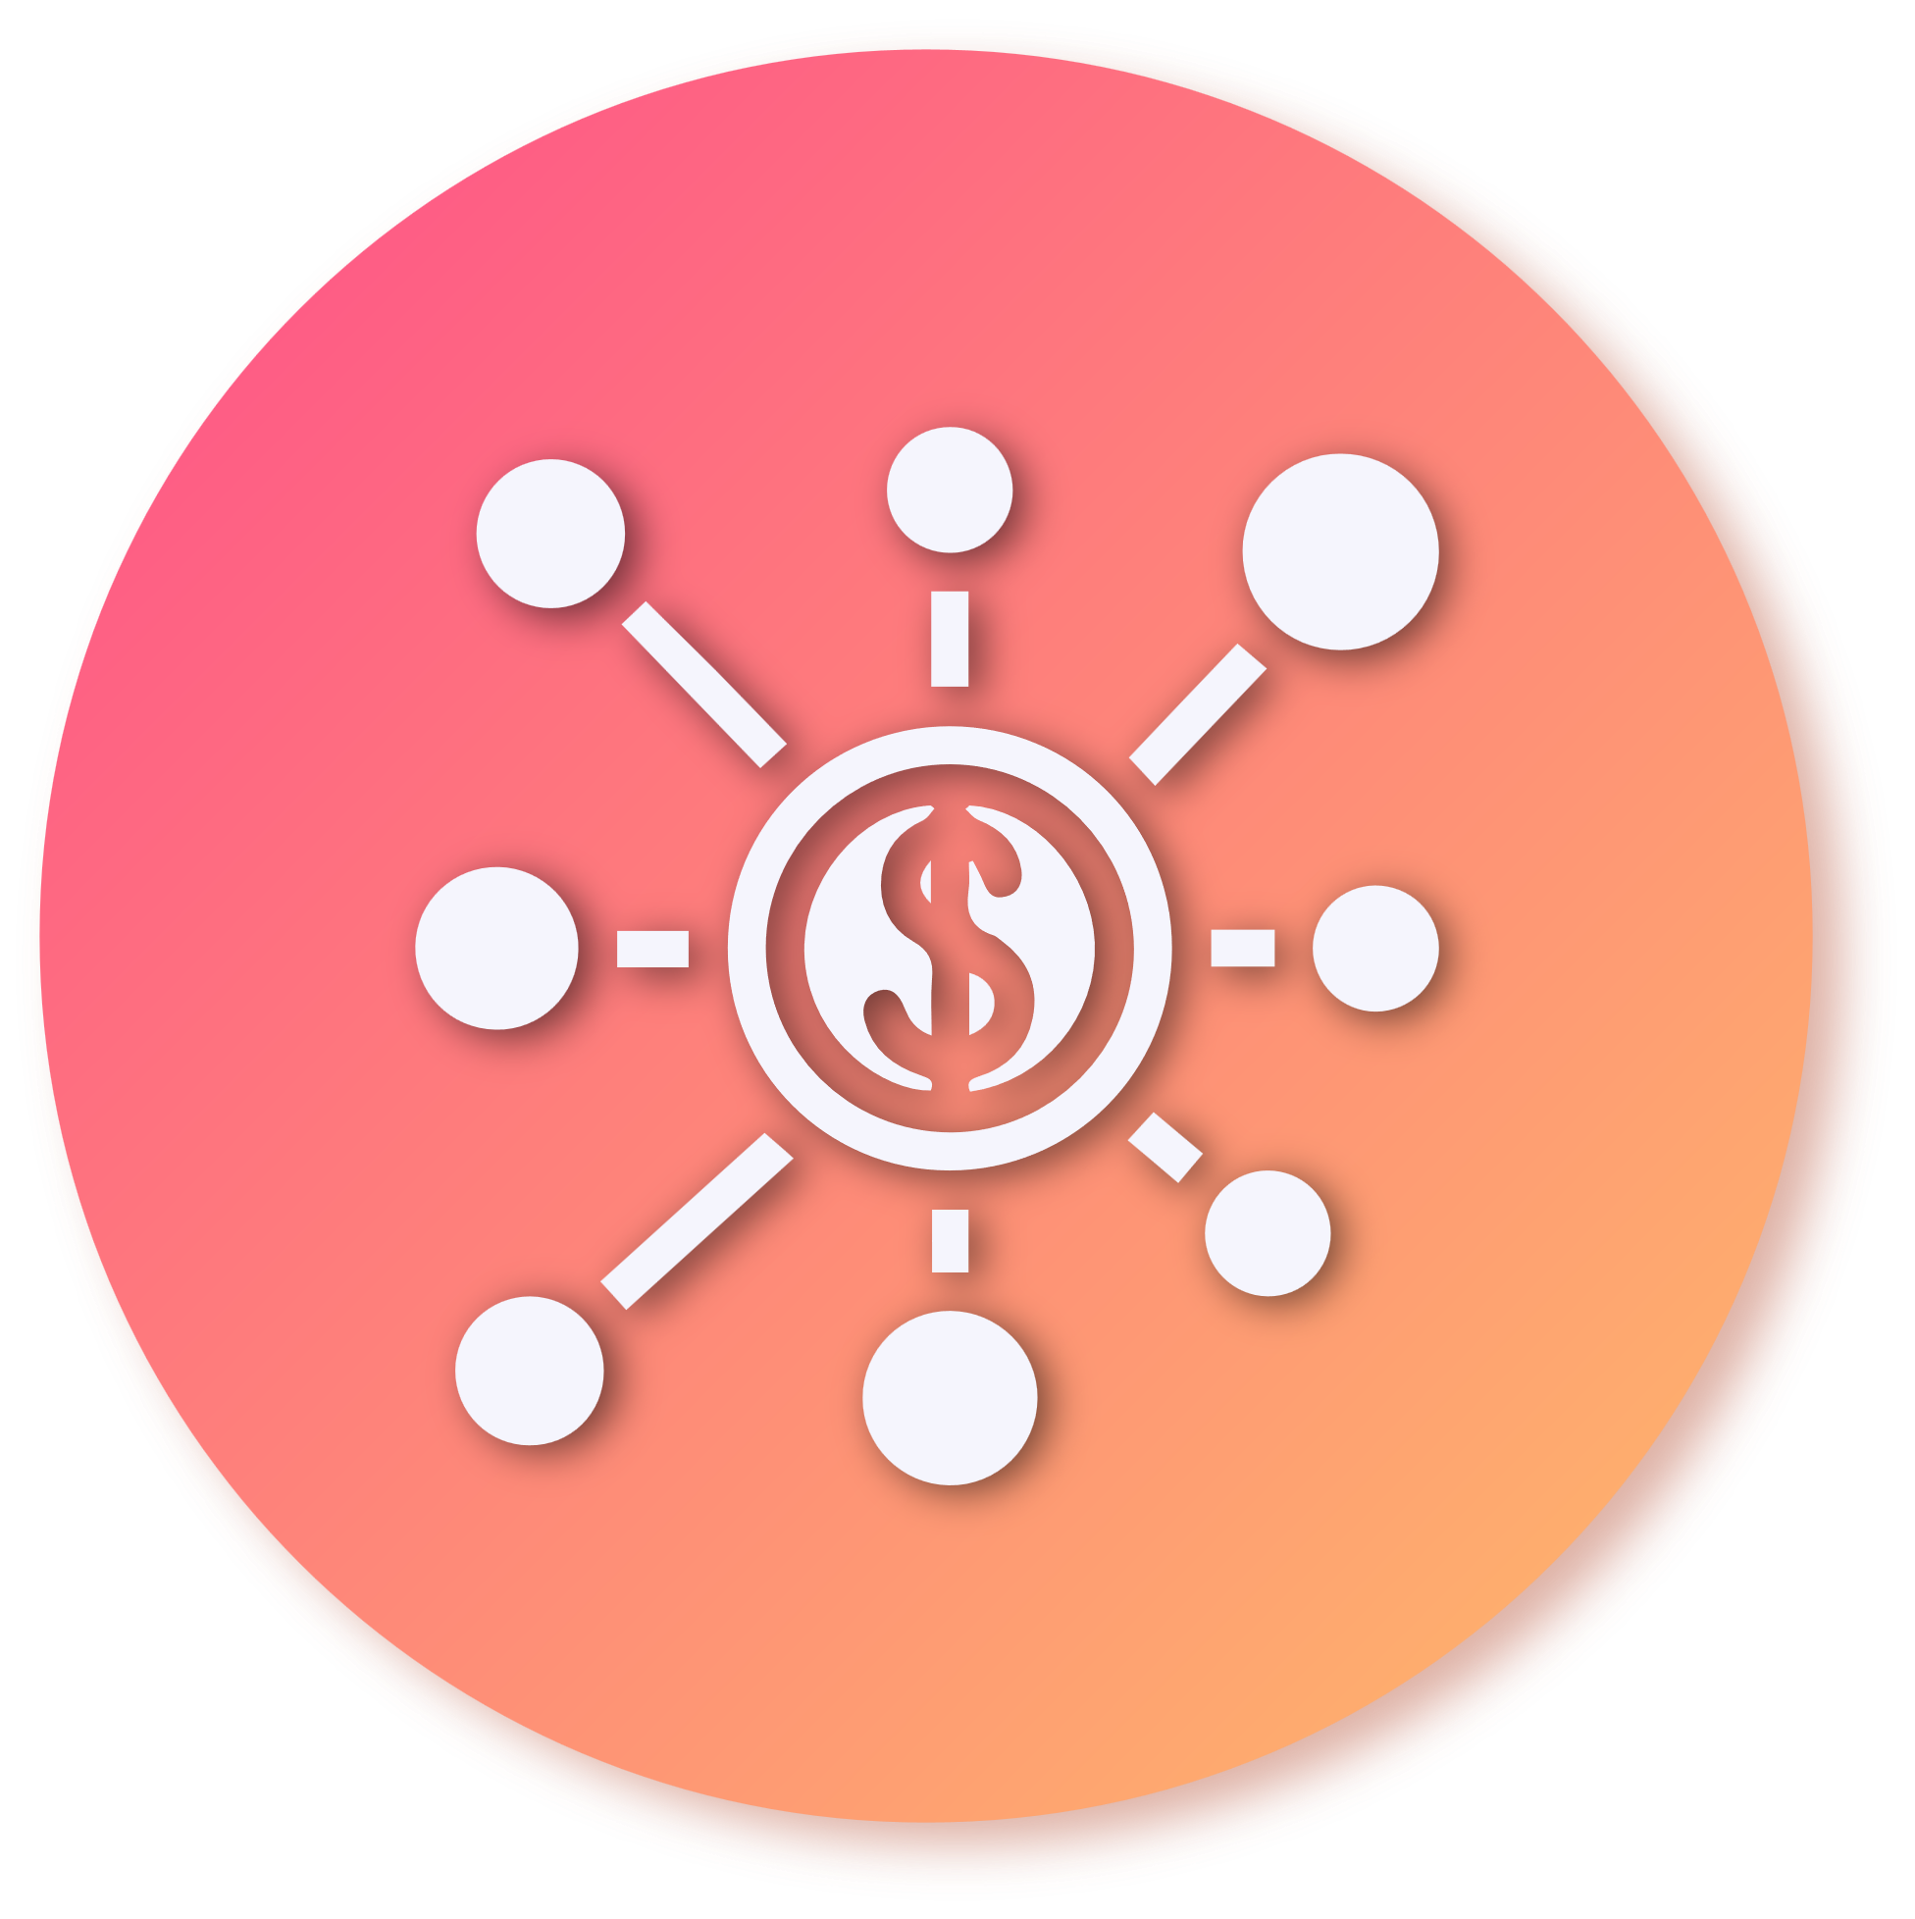
INVESTOR PROTECTION
Investor Security
Community Investor Decision
Money stored in Anchor Protocol, released using milestones under smart contract and investor approval

Slide 7



Provide
INCUBATION
Pre-select and prepare projects for community approval to assure successful fundraising and scalability.
Using team of industry experts to advise and pre-select projects from various industries on blockchain and real-world projects.

Slide 8






What is
TERRA
ECOSYSTEM?
Terra is the 2nd largest blockchain in terms of total value locked (TVL), with over $13 billion from 13 protocols.
Stable-coin-based system with strong community
Synthetic assets with ultra-low gas fees

Slide 9

ANCHOR
PROTOCOL
Anchor Protocol is a Terra-based application built by Terraform Labs (TFL).
Anchor is a savings protocol offering low-volatile yields and security on Terra stablecoin deposits.
Incentive for WFD token holders to stake and invest in projects, reducing volatility of the WFD token price.
Manage project fund distribution release using project milestone smart contracts, preventing scam with full transparency.
Notes:
- The Anchor protocol defines a money market between a lender, looking to earn stable yields on their stablecoins, and a borrower, looking to borrow stablecoins on stakeable assets.

Slide 10
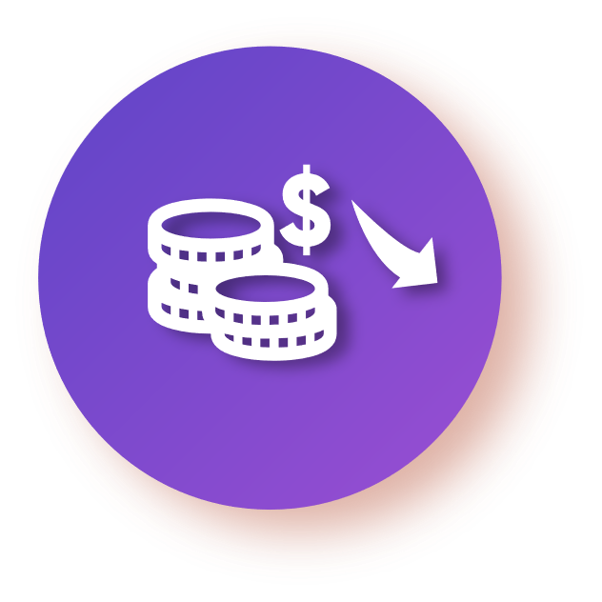
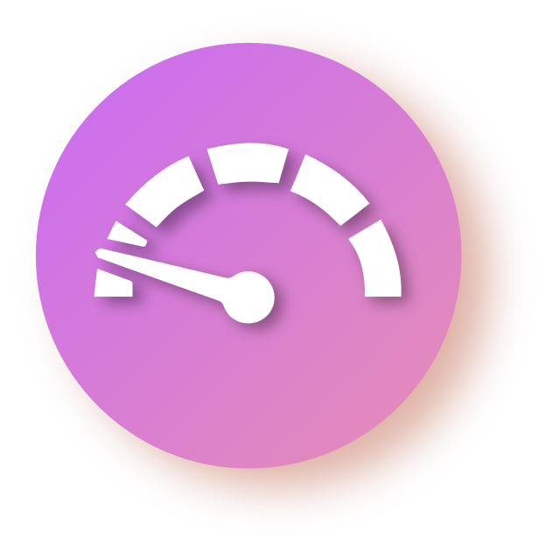



Secure & Refundable Deposits
Deflationary Token Value
Money Release With Milestone and Investor Vote Approval
Community Voting Power
COMPETITIVE ADVANTAGES
Cross-Chain Incubator
Investor Voting Power
Yield Benefit for Backers
Bridge Real-World and Blockchain

Slide 11
HOW THE WEFUND
PLATFORM WORKS
Project improvement & preparation for milestone delivery, roadmap, & community approval.
Seed Phase Fundraising:
- Each backer receives 1 vote per milestone.
- Seed round funds deposited in Anchor
- Project milestone smart contracts with automatic money release based on milestone investor community approval.
Pre-sale Fundraising:
- Each backer receives 1 vote per milestone
- Pre-sale round funds deposited in Anchor
- Project milestone smart contracts with automatic money release based on milestone investor community approval.
IWO
- Open for the public
- IWO funds deposited in Anchor until project is complete
- IWO project milestone smart contracts with automatic money release based on milestone investor community approval.
Deliver a winning project with full community approval, transparency, and minimal risk.
Project evaluation
* If projects do not meet milestones:
Delay – Work with project team and create time extension for milestone delivery.
Delete – Money returned to backers with Anchor yield

Slide 12
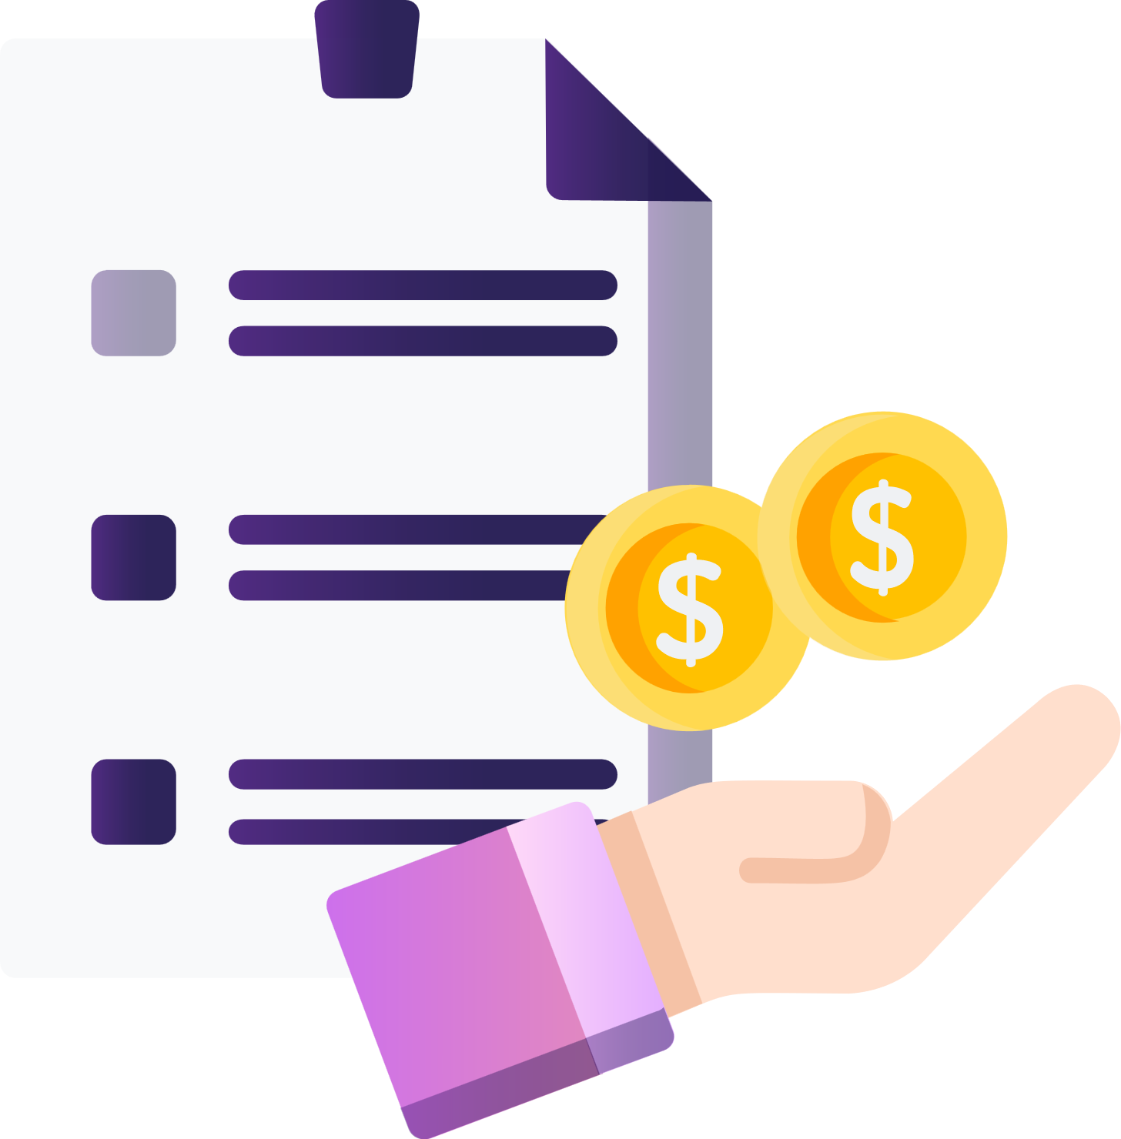

Money returned to backers with Anchor yield
Yield benefit for backers
Secure & refundable deposits
NO
HOW IT WORKS
New Project
Fundraising
Project milestone smart contracts with automatic money release
Investor approval
YES
YES
Deliver a winning project with full community approval, transparency, and minimal risk.
NO
Project Delivery
Community voting power

Slide 13
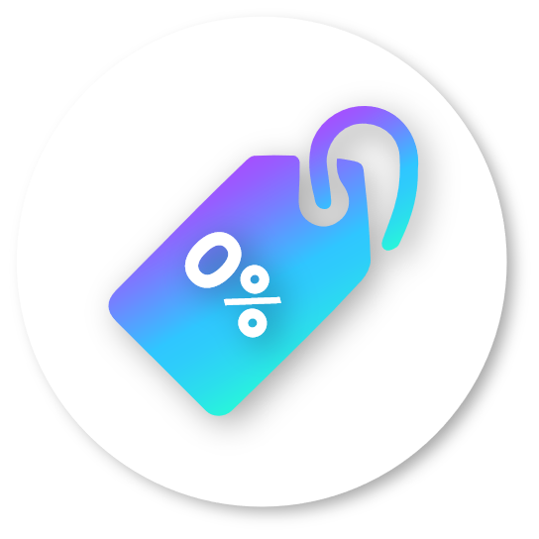
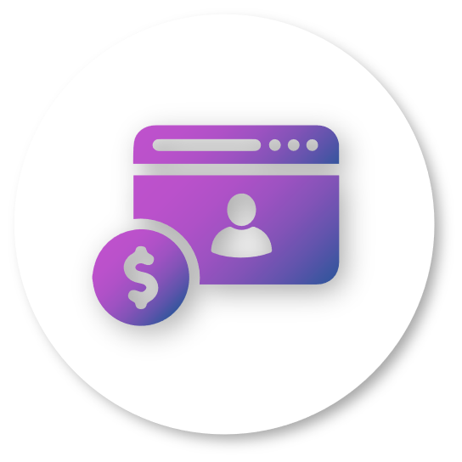




0% Transaction Fee
Due Diligence Rewards
Ads Payment
Increasing Value Through Deflationary Action
Prioritized Platform Placement
WEFUND
TOKEN UTILITY

Slide 14
WEFUND TECHNICAL
ROADMAP
A demo of WeFund platform to create projects, back projects, and stake in Anchor will be completed December 2021.
Have a full functionality platform with all functions mentioned in the Whitepaper2.0, by the TGE
Whitepaper 2.0 to be completed Q1 2022
Establishing a strong core team with strong knowledge, responsibility, team management, and holds a similar vision will be completed December 2021.
Finalized tokenomics, seed round closing date, pre-sale timeline, and IDO strategy will be completed December 2021.

Slide 15
TOKENOMICS
 | Token Value | Token WFD Amount | Target Amount
Seed | $0.06 | 10,000,000 | $600,000
PreSale | $0.09 | 7,000,000 | $600,000
IWO | $0.60 | 15,000,000 | $9,000,000
 |  | Total | $10,200,000

Slide 16
1
PRIVATE INVESTOR VESTING PERIOD
2
PRESALE VESTING PERIOD

Slide 17

3
4
TEAM TOKEN VESTING PERIOD
ICO/IDO VESTING PERIOD

Slide 18

PROFIT DISTRIBUTION

Slide 19
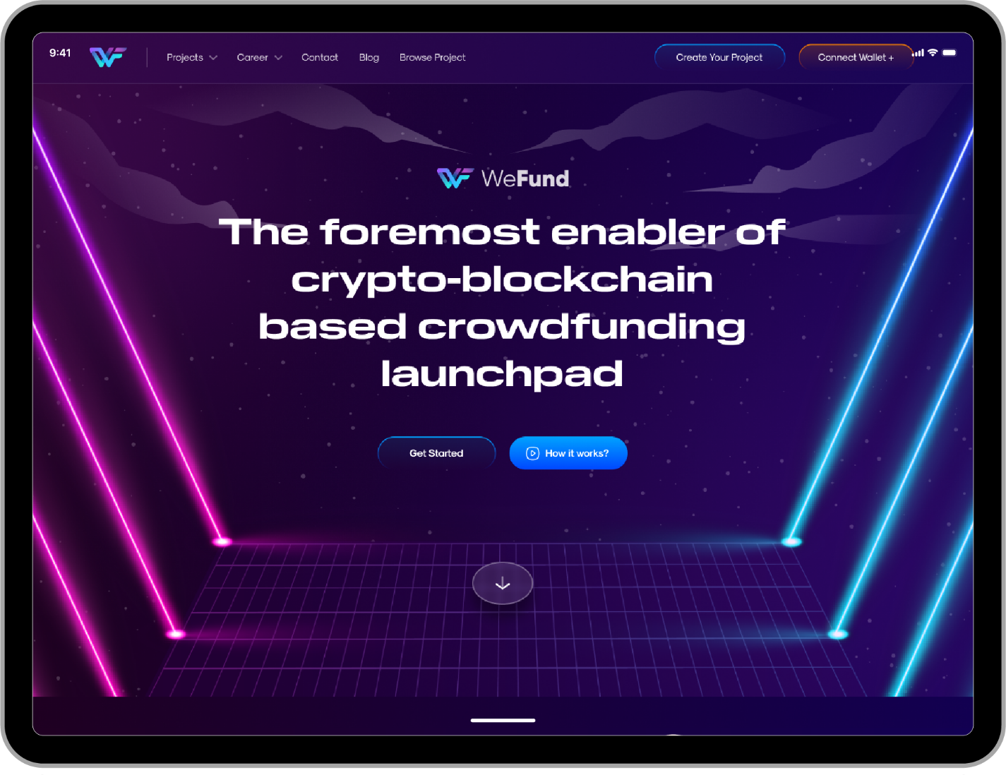
COMING SOON
A Kickstarter for Crypto Projects
Demo Platform released End of December
During the trial period, transaction fees are set to 5% to help autofinance the development
Notes:
Please update the design of the platform to be reflected on this presentation. – Work with Ika & Andrea on this
“COMING SOON”
“A Community Crowdfunding Cross-Chain Incubator”
“Demo Platform Launch December 2021”
“During demo period, transaction feed are to 5% to help finance platform development”

Slide 20
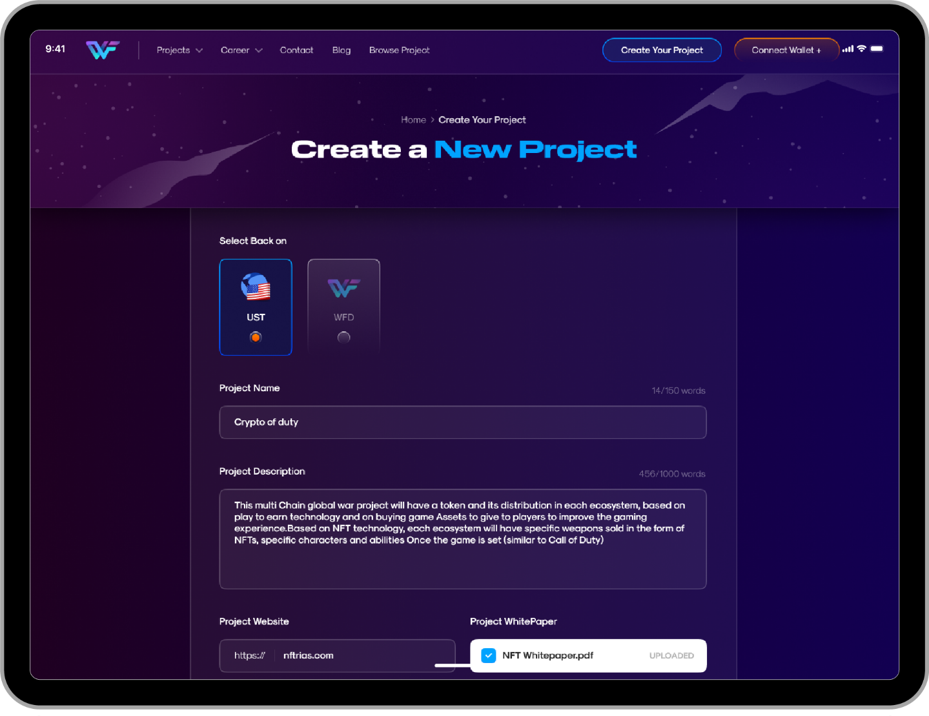
WEFUND INTERFACE
Sample (Project
Proposer)
VALIDITY PROCESS
Current Process :
1. Community Voting
2. Verified
3. Funding started
Notes:
Please update this slide with most current platform look – Work with Andrea & Ika on this
Remove “Validity Process”

Slide 21
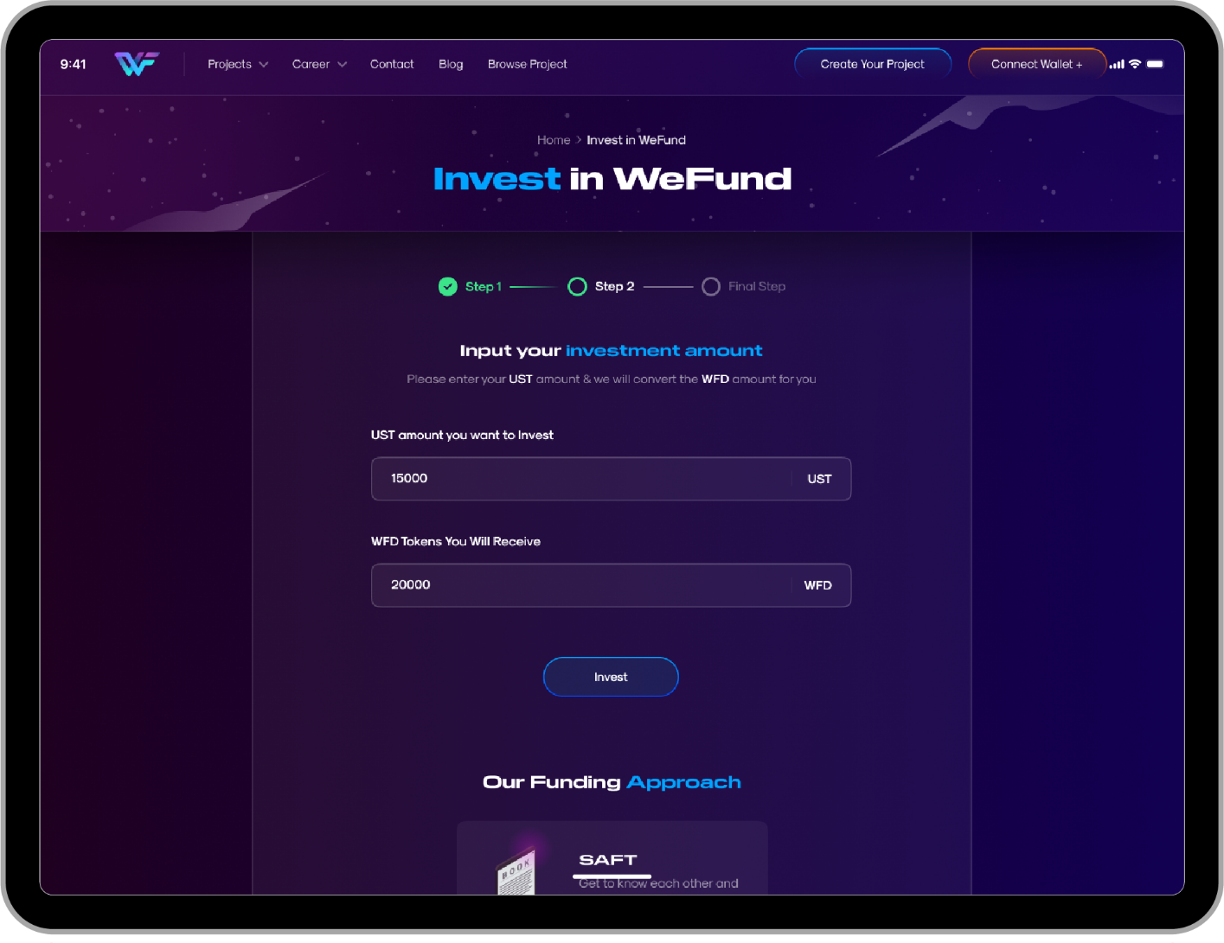
WEFUND INTERFACE
Sample (Investor)
Notes:
Please update this slide with most current platform look – Work with Andrea & Ika on this

Slide 22

1
4
WeFund provides investor security, prepares projects for community fundraising approval, and minimizes risk for the investor.
WeFund aim to deliver winning projects with full community approval, transparency, and minimal risk.
2
3
The quality of the WeFund platform reflects the high-quality projects hosted on the platform and its community.
Investors have the capability to approve project milestones.

Slide 23


THANK YOU
Let's keep in touch
https://wefund.app
WeFund_Official
info@wefund.app
@wefund777
WEFUND

